Slide 1
Query-to-Insight Analytics Engine AI-Powered Healthcare Analytics
Microsoft Innovation Challenge 2026 -
Team Members:
Ronaldo Garcia • Marco Portillo • Chris Orellana • Andy Llanos

Slide 2
Our team
Ronaldo Garcia
Marco Portillo
Chris Orellana
Andy Llanos
UCSD ‘23 BS Computer Science
ASU ‘26 BS Computer Science
UCSB ‘25 BS Applied Math
Lehigh ‘25 BS Computer Science

Slide 3
Overview
01.
02.
03.
04.
05.
06.
Problem
Solution
System Architecture
Healthcare data is complex, must comply with privacy regulations.
An AI-powered system that converts natural language into secure, validated SQL queries.
A full-stack pipeline using React, FastAPI, Azure OpenAI, and Azure SQL for real-time insights.
Security & Responsible AI
Demo
Impact
Role-based access control, SQL validation, bias, Content Safety Screening, safety filtering for secure analytics.
Live walkthrough of querying data, generating insights, and enforcing access restrictions.
Enables faster, safer, and more accessible decision-making in healthcare systems.
Notes:
This slide outlines our presentation. We’ll begin by discussing the problem of accessing complex healthcare data, followed by our AI-powered solution. Then we’ll walk through our system architecture, highlight our security and Responsible AI features, demonstrate the system in action, and finally discuss the broader impact.”

Slide 4
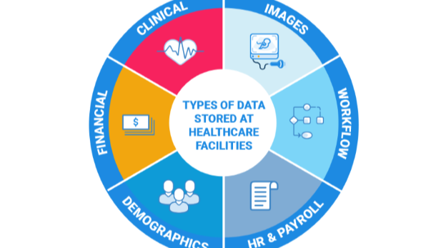
The Problem
Healthcare data is powerful, but inaccessible and risky to use.
Clinical data analysis depends on manual SQL query development
Requires both technical expertise and clinical domain knowledge
Relies on coordination between analysts and healthcare professionals
Results in slow turnaround times (weeks to months)
Healthcare data is complex and fragmented across different systems
Requires SQL expertise to access insights
Inconsistent & difficult to manage
Strict privacy & compliance requirements
High risk of unsafe or biased queries
Notes:
“Healthcare data is incredibly powerful, but in practice, it’s often inaccessible and difficult to use. Clinicians and analysts frequently have to wait hours or even days to get insights because accessing data requires SQL expertise and navigating strict compliance requirements. At the same time, there’s a high risk of unsafe or unauthorized queries, which makes data access both difficult and risky.”

Slide 5

Our Solution AI-powered analytics that transforms natural language into secure, actionable insights.
Ask questions in plain English, no SQL required
AI converts queries into validated, executable SQL
Built-in role-based access control (RBAC) ensures secure data access
Returns real-time insights, explanations, and structured results
What Makes This Unique
Secure by design: queries validated before execution
Permission-aware AI: enforces user roles automatically
Transparent: users can view generated SQL
Responsible AI: detects bias and sensitive access
Notes:
“Our solution is an AI-powered analytics engine that allows users to ask questions in plain English without needing SQL expertise. The system automatically converts those questions into validated SQL queries while enforcing role-based access control. It then returns real-time insights along with explanations and structured results. What makes our solution unique is that it is secure by design — every query is validated before execution, permissions are enforced automatically, and users can see exactly how the query was generated.”

Slide 6

System Architecture - Full Pipeline
System Flow Diagram
[Azure Static Web]
Client Tier
React Frontend
↓
[Azure App Service]
API Tier
FastAPI Backend
↓
Connected Azure Services
[ Azure OpenAI ] [ Content Safety ]
[ Azure SQL DB ] [ Redis Cache ]
↓
Results + Visualizations
Behind the Scenes
Multi-layer SQL validation (8+ checks)
Role-based access control (RBAC) enforced before execution
Built-in bias detection and audit logging
Notes:
Our system follows an end-to-end pipeline starting from a React frontend to a FastAPI backend, which orchestrates multiple Azure services. Azure OpenAI generates SQL and insights, Content Safety ensures safe inputs and outputs, Azure SQL stores structured healthcare data, and Redis caching improves performance for repeated queries. Behind the scenes, we enforce strict RBAC, multi-layer SQL validation, and audit logging to ensure secure and reliable analytics

Slide 7

Security & Responsible AI
Built with safety, compliance, and trust at every step of the pipeline.
Responsible AI Implementation
Security by Design
Role-Based Access Control (RBAC) restricts data by user role
Queries are validated before execution (multi-layer SQL checks)
Uses read-only database connections to prevent data modification
Enforces column-level and role-level access restrictions
Content safety filtering blocks harmful or unsafe inputs
Sensitivity classification (GREEN/AMBER/RED)
Bias detection flags demographic disparities (>20%)
Transparency, users can view generated SQL
Audit logging tracks all queries for accountability
Notes:
“This is where our system really stands out. Security and Responsible AI are not added features — they are built into every step of the pipeline. On the security side, we enforce role-based access control, validate every query before execution, and use read-only connections to protect the database. On the Responsible AI side, we implement content safety filtering, sensitivity classification, and bias detection to ensure safe and fair outputs. We also provide full transparency and maintain audit logs for accountability. Every query is secured, validated, and evaluated before execution.”

Slide 8
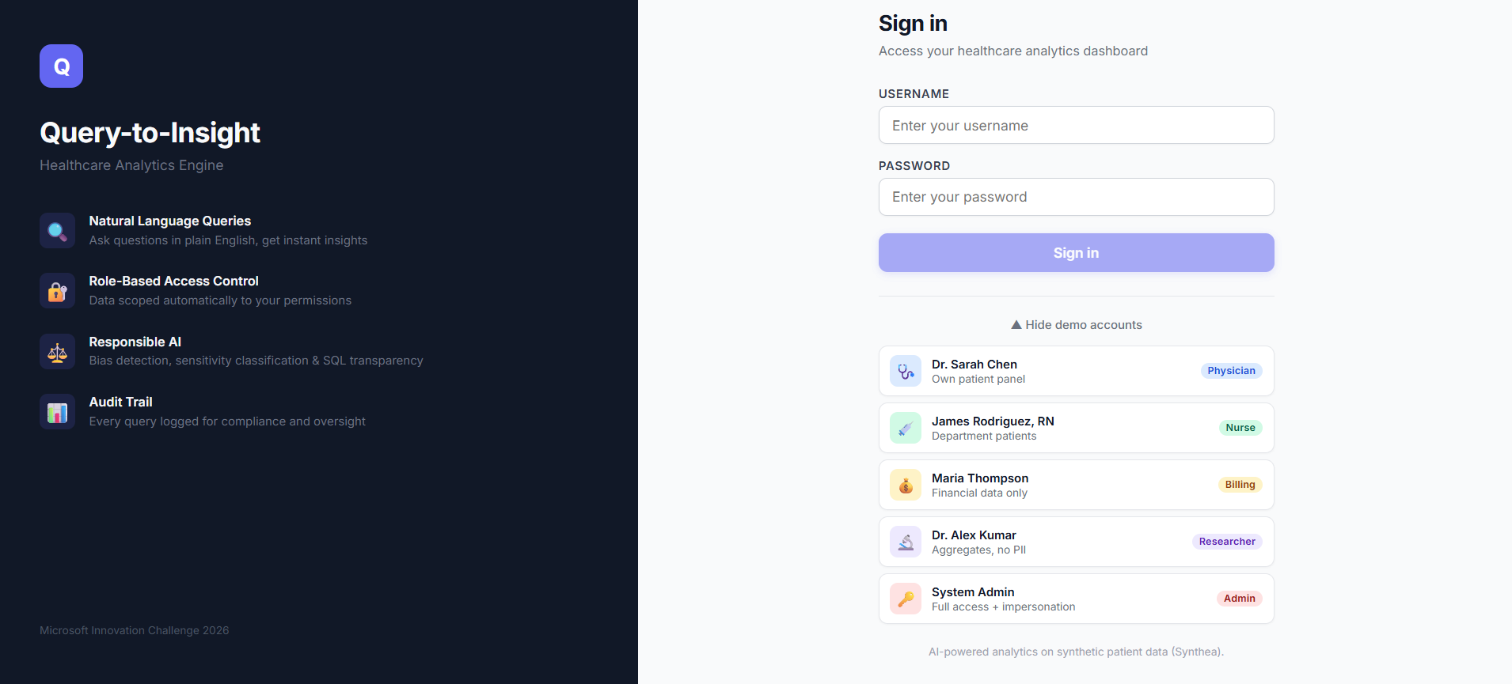
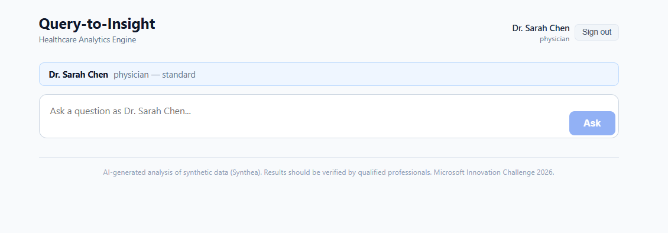
Live Demo
From question to insight, securely and intelligently.
Demo Walkthrough
User logs in with role-based access
Asks a question in plain English
AI generates and validates SQL
System enforces RBAC and security checks
Returns insights and structured results
Notes:
“Here’s how a user interacts with our system. First, the user logs in with a specific role, such as physician or billing. They then ask a question in plain English. The system uses AI to generate a SQL query, validates it, and enforces role-based access control before executing it. The results are returned as insights, tables, and visualizations. We also demonstrate how unauthorized queries are blocked, showing that our security and Responsible AI layers are actively working.”

Slide 9
Impact
Bridging the gap between healthcare data and real-world decisions.
Accessibility
Security & Compliance
Enables non-technical users to query complex data
Eliminates need for SQL expertise
Makes data-driven insights accessible to all roles
Ensures HIPAA-aware, role-based data access
Prevents unauthorized or unsafe queries
Provides auditability and transparency
Efficiency & Decision-Making
Reduces time from question → insight from hours to seconds
Supports real-time decision-making
Improves outcomes through data-driven insights
Notes:
“Our solution makes healthcare data more accessible, secure, and actionable. It allows non-technical users to query complex datasets without needing SQL expertise. At the same time, it enforces strict security and compliance through role-based access and validation. Most importantly, it reduces the time from question to insight from hours to seconds, enabling faster and more informed decision-making. Ultimately, we are bridging the gap between complex healthcare data and real-world decisions.”

Slide 10
Conclusion
What We Built
Why it matters?
An AI-powered system for natural language healthcare analytics
Secure pipeline with validation, RBAC, and Responsible AI
Real-time insights from complex healthcare data
Makes data accessible to non-technical users
Ensures safe and compliant decision-making
Bridges the gap between data and action
From question → insight, securely and intelligently.
Notes:
“To conclude, we built an AI-powered system that transforms natural language into secure, actionable insights. By combining validation, role-based access control, and Responsible AI, we ensure that healthcare data is both accessible and safe to use. Ultimately, our goal is to bridge the gap between complex data and real-world decisions.”

Slide 11

Secure. Intelligent. Accessible.
Healthcare insights for everyone.

